Slide 1
Azure Machine Learning

Slide 2
What is Machine Learning?
Computing systems that become smarter with experience
“Experience” = past data + human input
“
I need our systems to think. I need them to learn and I need them to present issues and problems and anomalies to the employees, to the managers.
Adam Coffey President and CEO
WASH Laundry Systems
”
Notes:
Machine Learning is a term that is not widely understood, perhaps you think of it as artificial intelligence or robotics or any number of things. It’s helpful to start with how Microsoft thinks of machine learning. Machine learning means computers that become smarter with experience. What do we mean by experience?
Experience is past data + human input. And that past data is often huge – the quantity of data is doubling about every 18 months and that’s only increasing from here. Computers can consider far more variables than a human making the same decision.
And what do we mean by human input? Human input takes two forms – the input of the user who is either communicating that the output is what they are looking to see or not. In the case that it’s not, the machine can either self-adjust to deliver better results moving forward or the advanced analytic developer or data scientist can make those changes to the model. Let’s look at examples from our own work over many years.
WASH video:
https://www.youtube.com/watch?v=iIYU1Xfhr8g&feature=youtu.be

Slide 3
What is Machine Learning ?
Using known data, develop a model to predict unknown data.
Notes:
Basic definition:
Machine learning develops algorithms for making predictions (statistical sense) from data *
Learning models from available training data, to make good predictions on unseen test data

Slide 4
Microsoft & Machine Learning Answering questions with experience
1991
1997
2008
2009
2010
2014
2015
Microsoft Research formed
Hotmail launches
Which email is junk?
Bing maps launches
What’s the best way home?
Bing search launches
Which searches are most relevant?
Kinect launches
What does that motion “mean”?
Skype Translator launches
What is that person saying?
Azure Machine Learning GA
What will happen next?
Machine learning is pervasive throughout Microsoft products.
Notes:
Microsoft has been working on machine learning for over two decades. We formed Microsoft research back in 1991 to tackle the tough problems internally that we’re enabling you to tackle yourselves today.
When we think of learning from experience – past data + human input – a great example is Hotmail. Back in 1997, external email was a relatively new concept. There wasn’t a lot to go on in terms of what email the customer wants and what they do not. With the rise of email, also came spam – and lots of it. Some of those issues were easy – like Nigerian princes we learned pretty quickly don’t give away their fortunes to strangers. But what about “free offer” – maybe that free offer is something the customer always wanted. Maybe it’s something they’d never want. But that’s where the “human input” part comes in as data is being collected – that takes the form of the actual user of the email service saying “yes, this is junk” or “no, I want this” and then the data scientist learning in aggregate and making tweaks to the underlying model in response.
And we kept going with that learning – relying on past data and human input to solve problems like the best way home, which search results are most meaningful to the user and one of the toughest ones to tackle with Kinect. Kinect’s past data was all in the lab – we didn’t have a product in market that captured user input and translated that to active game play so we had to make up the variables. But that only takes us so far. The researchers told me that one thing they didn’t consider was people answering the phone while playing. This happens a lot – and Kinect at first was translating this as a wild motion in the game play – essentially crashing people’s cars or any number of unintended consequences. That was the human input we rely on, which allowed us to learn quickly and adjust the underlying model to ensure that answering the phone would not be considered part of the game moving forward.
Skype translator is another huge machine learning problem to solve if you think of all the ways a person who is speaking English can pronounce the same word – tom-A-to or tom-AH-to – that’s the same word in French so Skype has to adjust quickly to ensure all the millions of variables are considered.
But what about using all this learning to predict what’s next? Many of the same algorithms running behind the scenes of our products in market today are available within Azure ML, allowing you to take your own past data and learn from it what will happen in the future for your business.

Slide 5
Christopher Bishop published a research paper in 1995 called Neural Networks for Pattern Recognition
When Bishop published his 2006 paper he was at Microsoft research.
Notes:
Christopher Bishop published a research paper in 1995 called Neural Networks for Pattern Recognition that presented the corpus of techniques that took machine learning from a statistical science to one inspired by the biological networks in our brains. Geoffrey Hinton noted in the foreward that Bishop “has wisely avoided the temptation to try to cover everything and has omitted interesting topics such as reinforcement learning, Hopfield Networks and Boltzmann machines in order to focus on the types of neural networks that are most widely used in practical applications”. DeepMind famously employed these techniques almost 20 years later to create a generalised AI that can learn to play Atari games at a superhuman level. When Bishop published his 2006 paper he was at Microsoft research.

Slide 6
How Are
We Different?
Enable custom predictive analytics solutions at the speed of the market
The main benefit we have experienced is that everything is in one place. Data is stored in the same place that hosts computations on the data.
Corey Coscioni West Monroe
“
”
Notes:
Now let’s dive in to how Azure Machine Learning works, and talk about what’s unique about our offering. It’s easier and faster to use than anything out there—truly enabling custom predictive analytics solutions at the speed of the market.
Alternate quote:
“Azure Machine Learning offers a data science experience that is directly accessible to business analysts and domain experts, reducing complexity and broadening participation through better tooling.”
Hans Kristiansen Capgemini

Slide 7
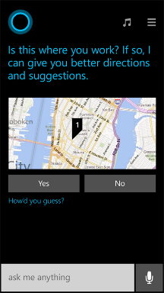
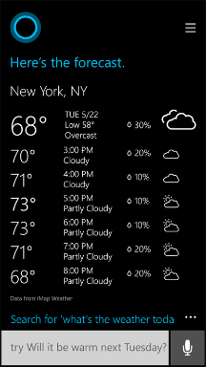
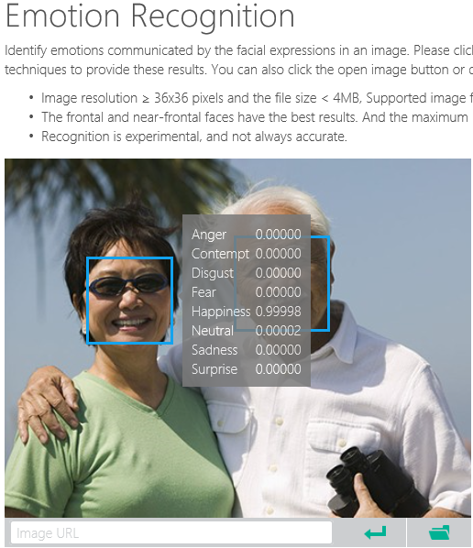
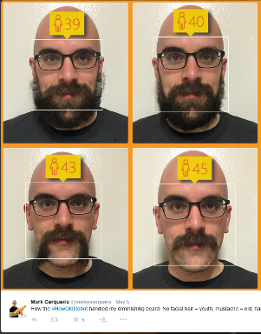
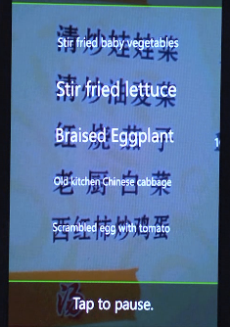
Why Machine Learning?
Notes:
Smart applications, services, platforms…
Digital Smart Personal Assistant
Image / Text / Data analyze

Slide 8
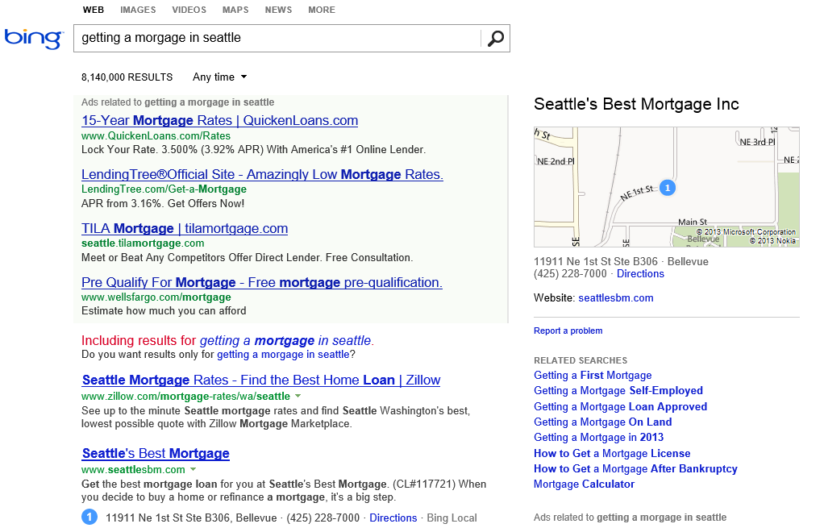
What is the probability of a click on each ad?
What language?
What is the intent?
Machine learning enables nearly every value proposition of web search.
Which ads to show, and in what order?
Are any of these pages malicious?
Misspelled?
What pages should we index?
What ad pricing will optimize revenue?
Which links are most likely to get clicked?
Notes:
The first “killer commercial application” of ML on Big Data was web search. With ML, we can use all of the billions of queries and associated clicks that we collect each month as training data for an ML system. That way, the system can learn, for each query, which web pages are likely the most relevant.
But the impact of ML goes beyond page relevance. With billions of queries, we can learn common misspellings and the native language of the user. We can discern the intent of the user – shopping? research? entertainment? ML can learn what kinds of pages are malicious.
ML also is able to learn, for each query, what kinds of ads are most likely to be clicked, and also learn how best to show the ads.
And even before we get to a real user, ML can be used to figure out what parts of the web are worth scanning, and what pricing for ads will optimize revenues.

Slide 9
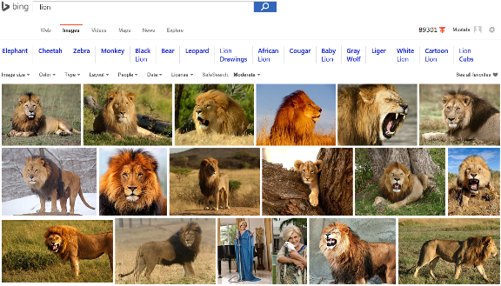
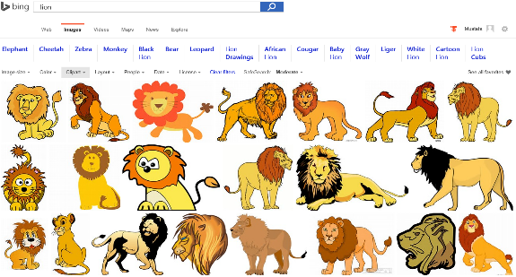
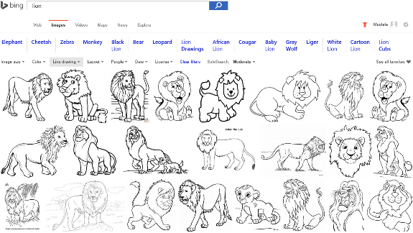
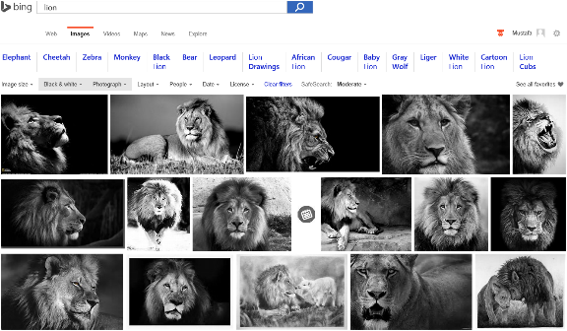
Image Analyze
Notes:
Search “lions” on Bing and change Image type etc. filters…
Behind the ML service categorizes the image db and returns the result.

Slide 10

Accent Color: Which border color is the best?
Notes:
Some another application on computer vision that meets with the machine learning

Slide 11
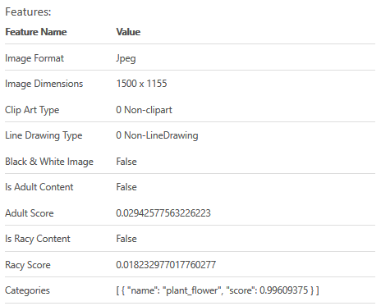

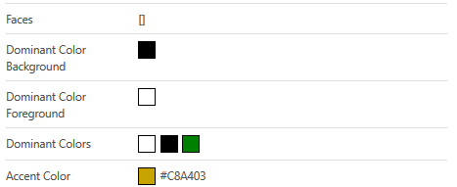
Accent Color: Analyze Image
Notes:
Goto https://www.projectoxford.ai/demo/visions#Analysis and analyze this image to find its accent color

Slide 12
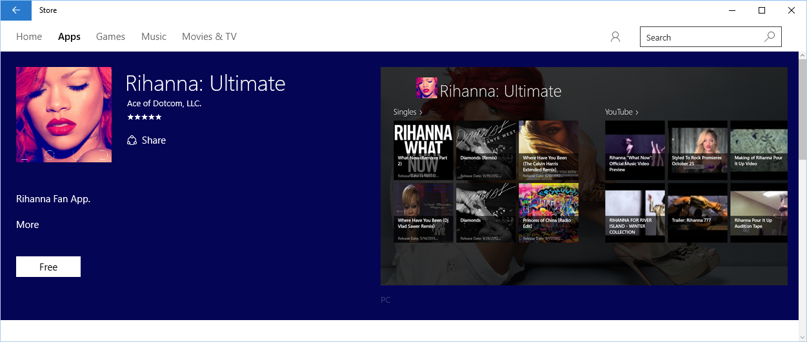
Accent Color: Windows 10 Store
Notes:
How to use accent color, case study.

Slide 13
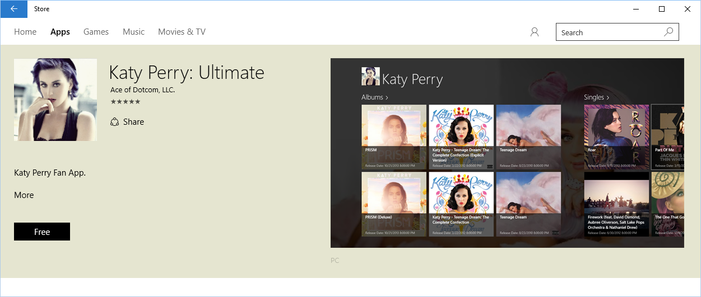
Accent Color: Windows 10 Store
Notes:
How to use accent color, case study.

Slide 14
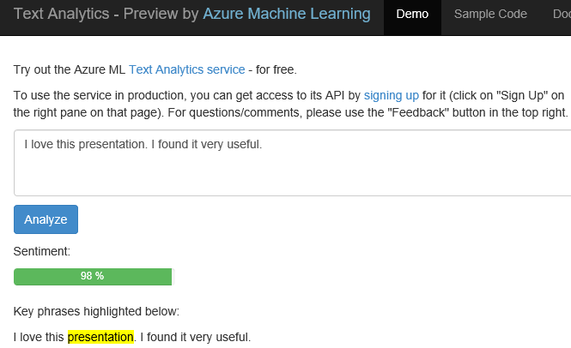
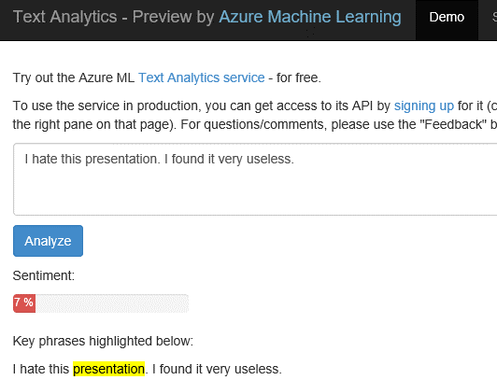
Text Analytics: User reviews
Positive
Negative
Notes:
Ready to use ML API published on Azure Datamarket place. A showcase of production ML solution in action (This can be used i.e. in shopping websites to see user reviews about a product etc.)
Test by yourself some of the reviews comments on Expedia or other online shopping sites. Copy/paste user comments to see the analyze result. If sentiment result shows higher percentage number, it means it is positive. If the percentage is low than it is a negative comment.
https://text-analytics-demo.azurewebsites.net/

Slide 15
The old Machine Learning landscape No improvement in generations
Expensive
Huge set-up costs of tools, expertise, and compute/storage capacity
Siloed data
Siloed and cumbersome data management restricts access to data
Disconnected tools
Complex and fragmented tools limit participation in exploring data and building models
Deployment complexity
Many models never achieve business value due to difficulties with deploying to production
Notes:
I mentioned earlier that data science and machine learning have been around a long time. This begs the question as to why it’s not being used more broadly. Essentially until now, this technology has been restricted to those with deep knowledge and deep pockets, available only to a specialized or well funded few.
Frankly, this work has been expensive. Our competitors are charging $100,000 a site license just to walk up to this solution, which doesn’t even speak to the time and cost to actually implement.
Second, the data management side is really cumbersome – in many cases we see the folks who are doing the data science work sitting in their own department – finance, operations, marketing – with access only to their siloed data and zero connection to the data sources they need in the greater organization.
Third, even if they have access to the data, they’re still often working in a vacuum on languages like R or Python that are completely unfamiliar to the rest of the development team.
Lastly, if they are able to solve all of these challenges, they then reach a roadblock actually putting their model into production, with models either becoming stale as they wait to be deployed or growing stale in production because the process to get them there was too time consuming to repeat.
But now there is a solution to all this. How? The Cloud. The Cloud changes the game.

Slide 16

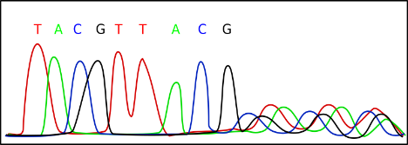
Data Science
Data Science is far too complex
Cost of accessing/using efficient ML algorithms is high
Comprehensive knowledge required on different tools/platforms to develop a complete ML project
Difficult to put the developed solution into a scalable production stage
Need a simpler/scalable method:
Azure Machine Learning Service
Notes:
Actually it is the science on data

Slide 17

Microsoft Azure Machine Learning
Make machine learning accessible to every enterprise, data scientist, developer, information worker, consumer, and device anywhere in the world.

Slide 18
From data to decisions and actions
Data
Recommendations
What should I do?
Decision
Action
Decision automation
Decision support
Predictions
What will happen?
Interactive dashboards
Why did it happen?
Static reports
What happened?
Manual process
Value
Notes:
Azure ML aims to transform your data in to an intelligent action

Slide 19






Transform data into intelligent action
Information Management
Big Data Stores
Machine Learning and Analytics
Dashboards and Visualizations
Business apps
Power BI
Azure
Data Factory
Azure
Machine Learning
Personal Digital Assistant
Azure
Data Lake
Cortana
People
Custom apps
Azure
Data Catalog
Azure
HDInsight (Hadoop)
Perceptual Intelligence
Azure
SQL Data Warehouse
Face, vision
Speech, text
Azure
Event Hub
Azure
Stream Analytics
Business Scenarios
Sensors and devices
Recommendations,
customer churn,
forecasting, etc.
Automated Systems
DATA
INTELLIGENCE
ACTION

Slide 20
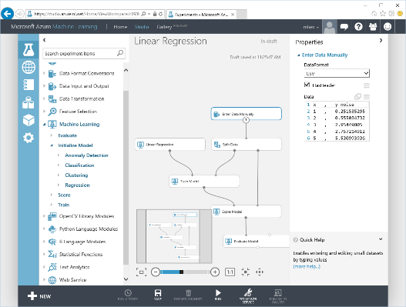
Microsoft Azure Machine Learning
Web based UI accessible from different browsers
Share|collaborate to any other ML workspace
Drag&Drop visual design|development
Wide range of ML Algorithms catalog
Extend with OSS R|Python scripts
Share|Document with IPython|Jupyter
Deploy|Publish|Scale rapidly (APIs)
Notes:
Lets look at some of the features of ML Studio

Slide 21
Why Azure Machine Learning Built for a cloud-first, mobile-first world
Fully managed
Integrated
Best in Class Algorithms, R, Python
Deploy in minutes
No software to install, no hardware to manage, and one portal to view and update.
Simple drag, drop and connect interface for Data Science. No need for programming for common tasks.
Operationalize models with a single click. Monetize in Machine Learning Marketplace.
Built-in collection of best of breed algorithms. R, CRAN packages, and Python
Compliance:
ISO 27001 & ISO 27018 certified
EU Model Clause compliant
Notes:
Microsoft built our machine learning solution as part of Azure so it comes with all the benefits of the cloud. Scalable, no new hardware investments, pay as you go, and as you see value. Let’s review a snapshot of the key benefits here.
First and foremost, it’s comes fully managed. No software to install, no hardware to manage, and no updates to worry about. and one portal to view and update. And it’s all based in Azure, so there is one portal to manage, monitor and update the solution. No moving back and forth between technologies or struggling with integrations.
It’s Integrated. This is what customers expect from Microsoft and here we deliver in a space where ease of use is lacking today. The visual interface provides simple, drag, drop and connect features. Users can easily access it from anywhere, and share across geographies.
Azure Machine Learning is the result of years of innovation, so it comes packed with best in class algorithms like the ones that power Bing and Xbox. There are sample experiments to help customers quickly get started, support for custom R solutions so customers don’t lose investments they’ve already made in machine learning—easily port over their current solutions – no wasted work. And it supports over 350 open source R packages.
And uniquely in the market customers can deploy solutions in minutes.

Slide 22





Analyst
Differentiation
Data
scientist
Developer
Accessibility
Model Your Way
[Data Scientist]
All Skill Levels
Business-tested Algorithms
R & Python
Deploy in Minutes
[Data Scientist, IT & Developers]
One Click Deployment
Manage via Cloud Portal
Model accessed as a Web Service
Expand your Reach
[Ecosystem & Developers]
Product Gallery
Azure Marketplace
The Data Science “Inside”
Notes:
But we’re changing all that through our vision of accessibility to all
We first provide a modeling experience that welcomes all skill levels. Data scientists can use trusted algorithms from Xbox and Bing without writing one line of code. Or, more seasoned data scientists can mix and match with Python and R built in, or drop in their custom code. So – literally – the tool speaks their language.
Then we can deploy in minutes as a web service – the one-click deployment is unique to Microsoft
Then users of the product can both deploy their solution to the community through the in-product Gallery http://gallery.azureml.net/ or learn best practices for their own solutions. They can then take it a step further with global scale through the Azure Marketplace, https://datamarket.azure.com/browse?query=machine+learning where partners and individuals can brand and monetize their solutions and developers can access them with no data science skills needed – the data science is inside.

Slide 23
Microsoft Azure Machine Learning Built for a cloud-first, mobile-first world
Fully managed
Integrated
Flexible
Deploy in minutes
No software to install, no hardware to manage, all you need is an Azure subscription.
Drag, drop and connect interface. Data sources with just a drop down; run across any data.
Built-in collection of best of breed algorithms with no coding required. Drop in custom R or use popular CRAN packages.
Operationalize models as web services with a single click. Monetize in Machine Learning Marketplace.

Slide 24
Microsoft Azure Machine Learning
ML Algorithms
Best of MS
ML Studio
Data Scientist
ML Operationalization
IT Professional
ML APIs Marketplace
ISVs & Developers
Notes:
How customers generally benefit from Azure ML

Slide 25
Azure Machine Learning Ecosystem
Provision Workspace
Build ML Model
Deploy as Web Service
Publish an App
Get/Prepare Data
Publish Web Service
Get Azure Subscription
Create Workspace
Evaluate Model Results
Build/Edit Experiment
Azure Data
Marketplace
Create/Update Model
Notes:
Stages to develop end to end Azure ML solution. First you need an AML workspace... then you build a model under AML Studio, then publish it as web service and as an app (see text analytics demo in prior slides)

Slide 26
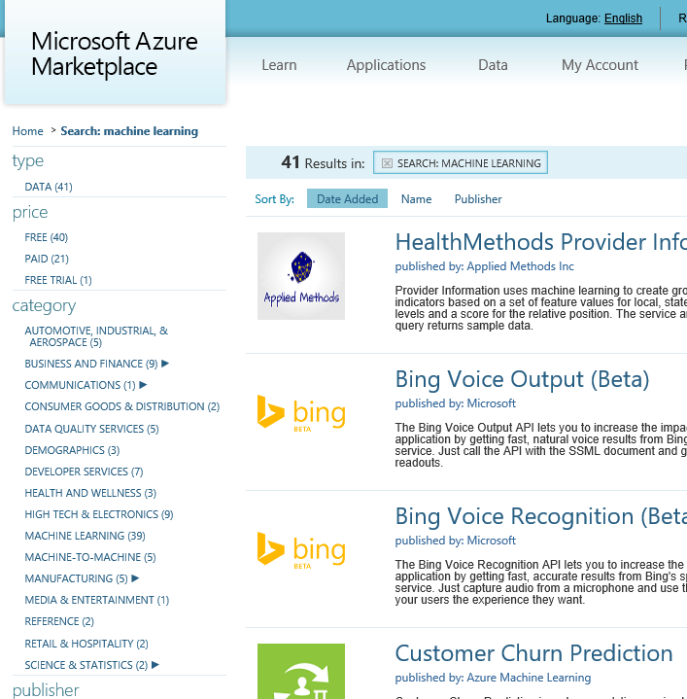
API examples
Green Score, Wealth Score, Giving Score
Frequently Bought Together API
Recommendations API
Anomaly Detection API
Lexicon Based Sentiment Analysis
Forecasting: Exponential Smoothing
Forecasting: ETS+STL
Forecasting: AutoRegressive Integrated Moving Average (ARIMA)
Binary Classifier API
Cluster Model API
Survival Analysis API
Multivariate Linear Regression API
Survival Analysis API
Multivariate Linear Regression API
Normal Distribution Quantile Calculator
Binomial Distribution Quantile Calculator
And more on datamarket.azure.com
Notes:
https://datamarket.azure.com/browse?query=machine+learning
Some of the ready to use ML Api available for end users.
Recently announced most of them as Microsoft Cognitive Services that is available under Microsoft Azure (new) portal. Search available services with “cognitive” keyword under new portal.
You can create i.e. face recognition service under Azure portal to be used in apps.

Slide 27
Azure Machine Learning Service Data -> Predictive model -> Operational web API in minutes
Data
Clients
API
ML STUDIO
Model is now a web service that is callable
Blobs and Tables
Hadoop (HDInsight)
Relational DB (Azure SQL DB)
Integrated development environment for Machine Learning
Monetize the API through our marketplace
Notes:
So let’s take a look at the technology itself. The elegance of the solution is in its simplicity – something that has been lacking in the machine learning space which is a key reason this space has not improved in generations. But we are here to change this.
The first issue many enterprises face is data ingestion. With the cloud, you can bring in data sources with the ease of a drop down or drop your on-premises data set into the built in storage space. Users can then model in our development environment – Machine Learning Studio – where we’re offering R, Python and SQLite as first class citizens in addition to our world-class Microsoft algorithms.
The second issue – and often the primary one – is putting finished work into production in a way others can use. We’ve heard from many data scientists that they model in R on a Linux stack but then have to hand over their work to developers who need to translate that into another language to actually make it work. This time consuming and unnecessary process has been eliminated with our system, as the model is with a click transformed into a web service end-point that can run over any data, anywhere and connect to any solution or client.
Next, not only can this model be put into production for your company, it can be made available for the world on our Machine Learning Marketplace. Microsoft hosts your solution and markets it for you, while you have the freedom to brand and monetize as you see fit. We also offer a number of Microsoft solutions here.

Slide 28
Azure Machine Learning Service Data -> Predictive model -> Operational web API in minutes
Data
Clients
API
ML STUDIO
Model is now a web service that is callable
Blobs and Tables
Hadoop (HDInsight)
Relational DB (Azure SQL DB)
Integrated development environment for Machine Learning
Monetize the API through our marketplace
Notes:
With the cloud, you can bring in data sources with the ease of a drop down or drop your on-premises data set into the built in storage space. Users can then model in our development environment – Machine Learning Studio – where we’re offering R, Python and SQLite as first class citizens in addition to our world-class Microsoft algorithms.
The second issue – and often the primary one – is putting finished work into production in a way others can use. We’ve heard from many data scientists that they model in R on a Linux stack but then have to hand over their work to developers who need to translate that into another language to actually make it work. This time consuming and unnecessary process has been eliminated with our system, as the model is with a click transformed into a web service end-point that can run over any data, anywhere and connect to any solution or client.
Next, not only can this model be put into production for your company, it can be made available for the world on our Machine Learning Marketplace. Microsoft hosts your solution and markets it for you, while you have the freedom to brand and monetize as you see fit. We also offer a number of Microsoft solutions here.

Slide 29
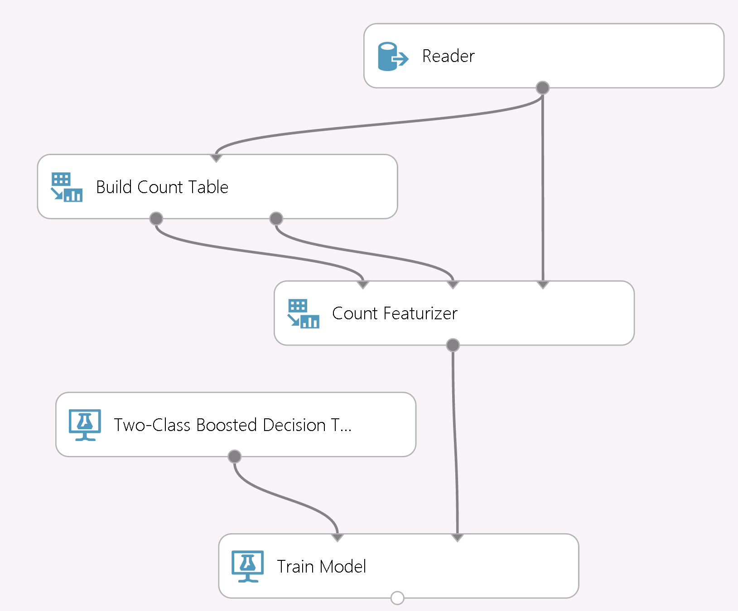
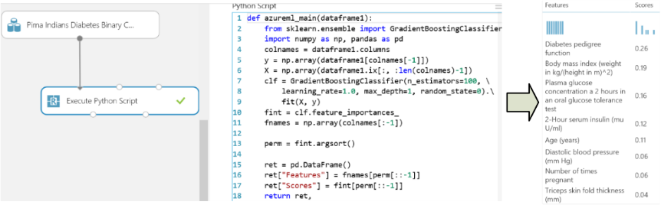
Model Your Way: Open source/our source
Script with R, SQLite or Python
CPython 2.7 support from inside AML Studio
numpy/scipy/panda/scikit-learn/etc.
Anaconda distro pre-installed
Python client library
Analyze data using Python and its libraries
Use IPython, PTVS, Eclipse to edit/debug
Big learning with counts
TB scale datasets
Modular: tune/monitor/replace in isolation
Monitorable and debuggable
Notes:
Our embrace of open source continues with our GA release by now adding to our full support of R with new first class support for SQLite and Python. Just as you can with R, you can drop your custom Python code directly into ML Studio.
You can then combine your custom work with our world-class algorithms such as learning with counts, which allows you to digest terabytes of data – truly a Big Data solution in the cloud.

Slide 30
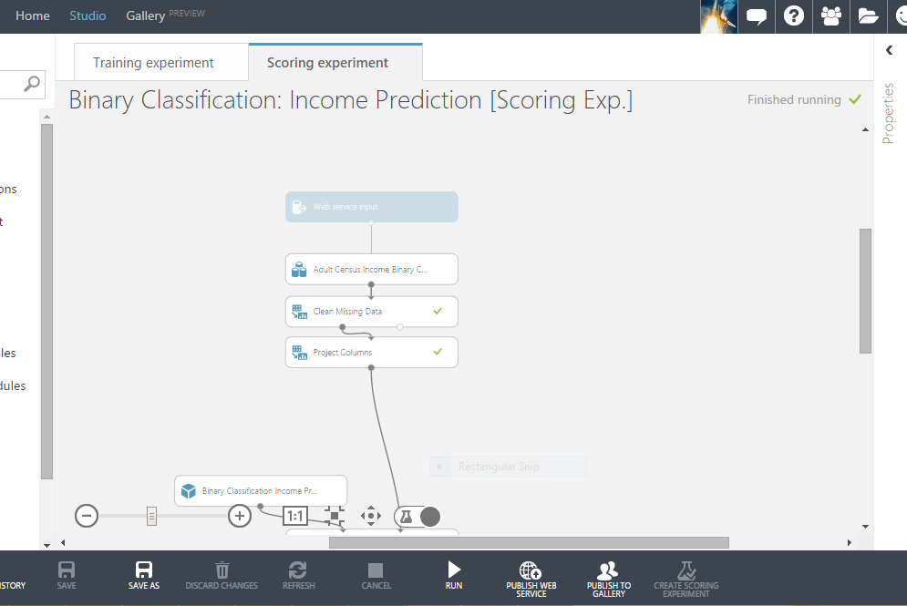
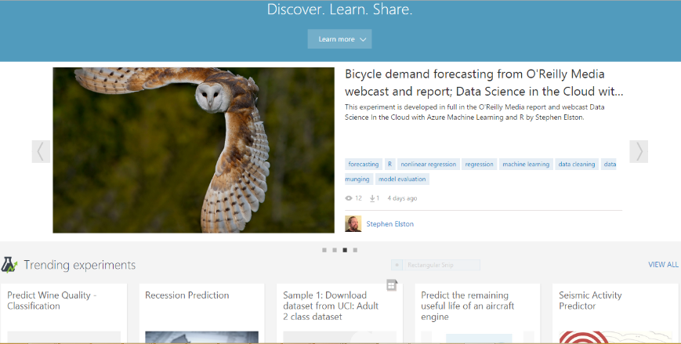
Deploy in Minutes
Expand your Reach
One click to production
Publish as a Web Service or to Gallery
Continuous updates to streamline process Stay tuned to our blog for more
New in-product Gallery
Discover what others have built Learn by dropping these into your workspace
Share your work with others
Notes:
And, as I’ve mentioned, no other vendor offers the ability to deploy with one click – you can literally see the button here. It is simply powerful to be able to put your models into production and increase their usability for businesses, the community and the world.
And we’re enabling the community of Azure ML users by offering an in-product Gallery where you can discover solutions built by others, drop those directly into your workspace for experimentation and learning, as well as easily share your own work in the gallery with the same ease of use you experience with web service production. You can try this out by logging on to azure.com/ml and clicking “get started” to try our perpetually free version.

Slide 31




What can Azure ML do for you…?
Telemetry data analysis
Buyer propensity models
Social network analysis
Predictive maintenance
Web app optimization
Churn analysis
Natural resource exploration
Weather forecasting
Healthcare outcomes
Fraud detection
Life sciences research
Targeted advertising
Network intrusion detection
Smart meter monitoring

Slide 32
R and Python Jupyter Notebooks

Slide 33

What is R?
Data analysis software
Used by 2M+ data scientists, statisticians and analysts
Statistical programming language
Flexible, extensible and comprehensive for productivity
Enables beautiful and unique data visualizations
As seen in New York Times, The Economist and FlowingData
Fills the Data Science talent gap
New graduates prefer R
Thriving open-source community
Leading edge of analytics research

Slide 34
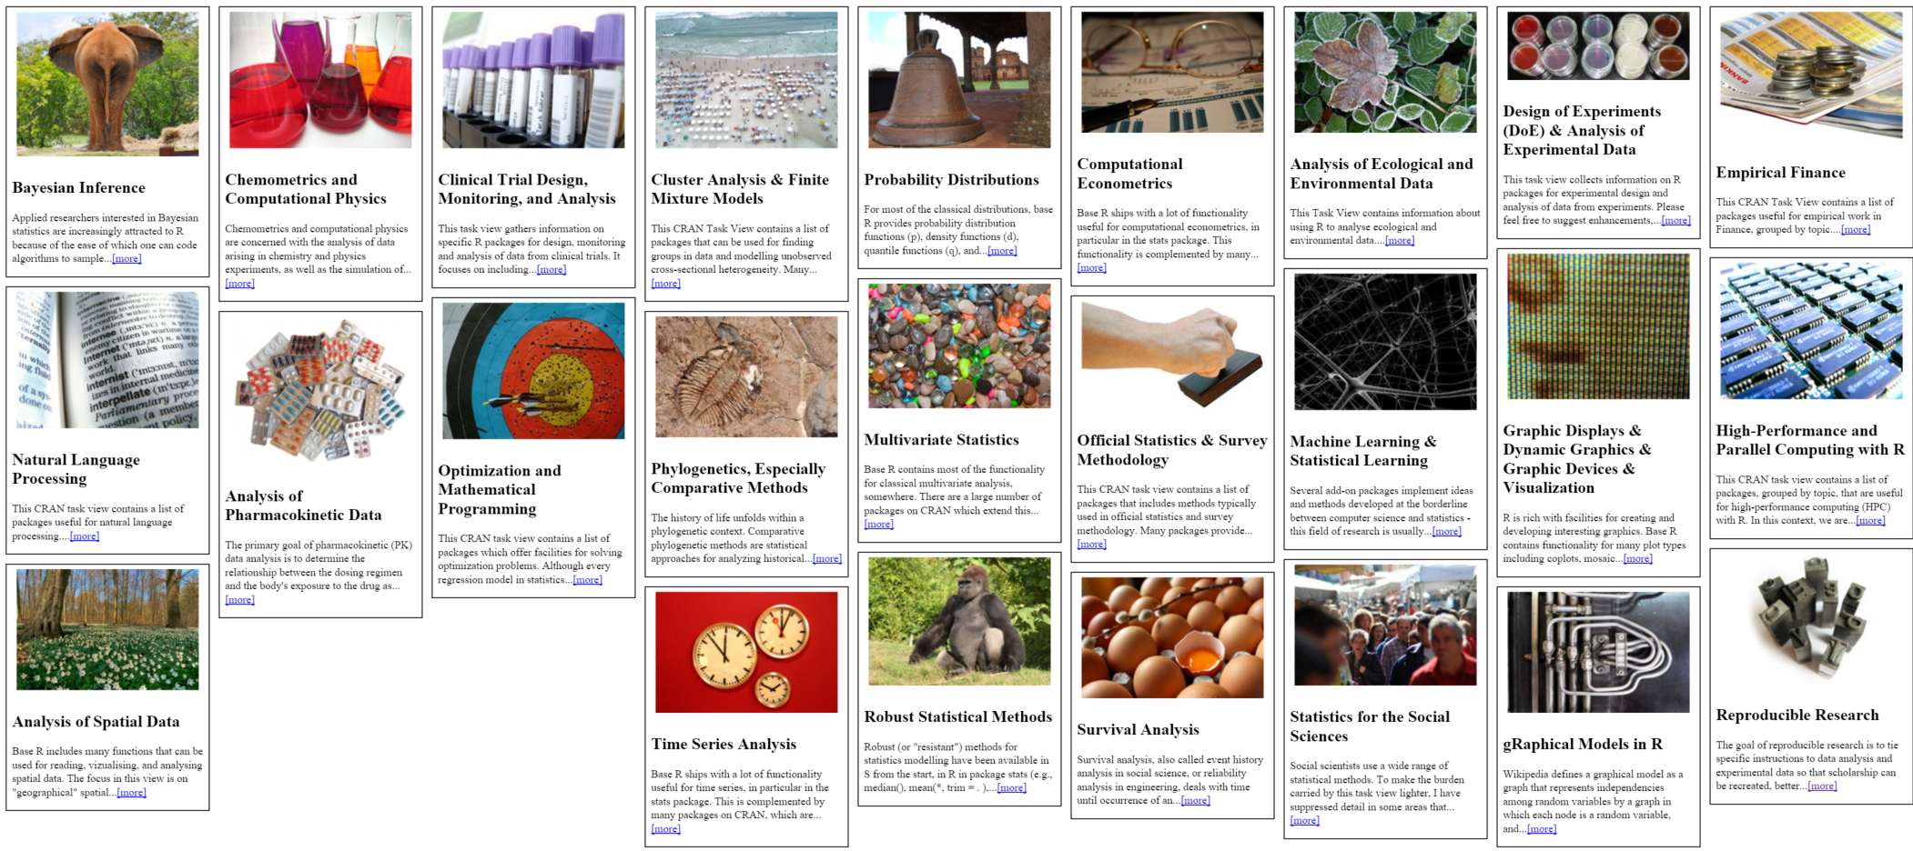
CRAN: 7000+ add-on packages for R
CRAN Task View by Barry Rowlingson: http://www.maths.lancs.ac.uk/~rowlings/R/TaskViews/

Slide 35
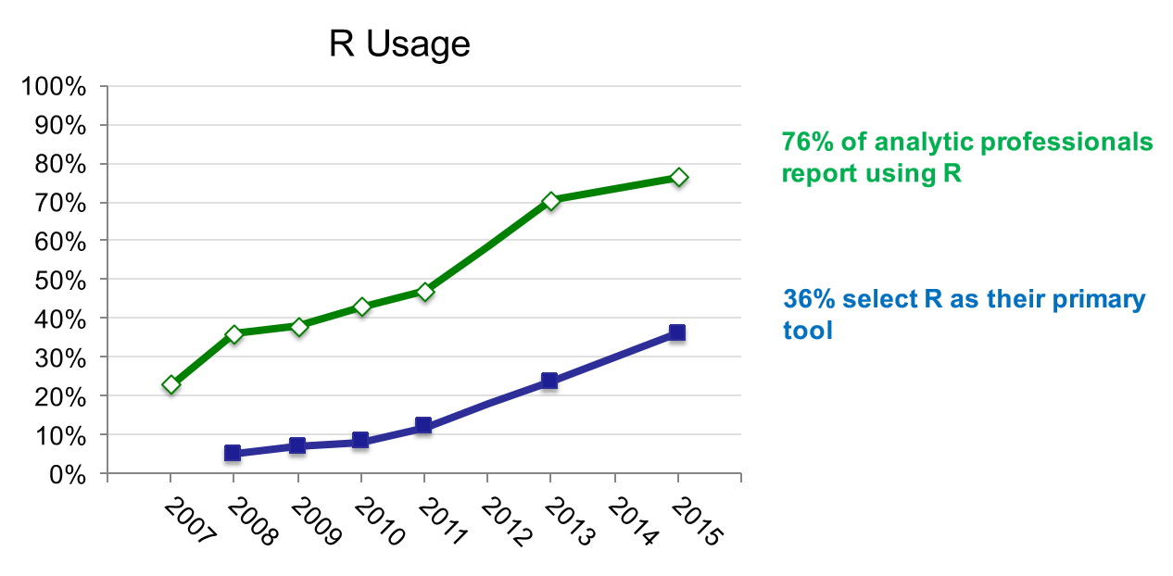
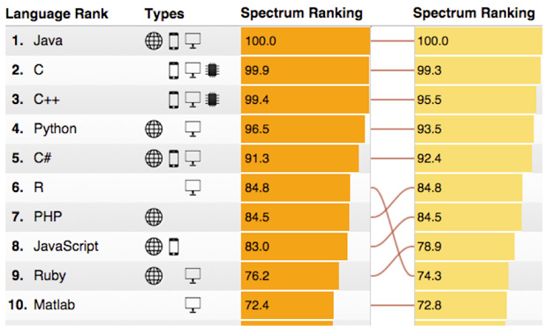
R: The #1 software for Data Science … and #6 amongst general-purpose programming languages
R Usage Growth
Rexer Data Miner Survey, 2007-2015
Language Popularity
IEEE Spectrum Top Programming Languages, 2015
76% of analytic professionals report using R
36% select R as their primary tool

Slide 36
Use Cases & Customer Stories

Slide 37
Machine Learning in action
Competitive differentiation through accessibility
We wanted to go beyond the industry standard of preventative maintenance, to offer predictive and even preemptive maintenance.
Andreas Schierenbeck
CEO, ThyssenKrupp Elevator
“
”

Slide 38

At Pier 1 Imports, we’ve embraced the cloud. It helps us operationalize technology quickly and react to our ever-evolving business needs
Andrew Laudato Pier 1 Imports
Personalized offers
“
Retailer Pier 1 Imports wanted to offer a connected, personal experience both online and in store
”
Notes:
How that connected experience offered differentiation to Pier 1.
Deliver the right message at the best time using the most effective marketing vehicle
Product choices per store and online based on past local and global purchase preference
Seamless customer experience from brick and mortar to online
Leader in omni-channel retailing
https://www.youtube.com/watch?v=fN8Cixcc5yg&feature=youtu.be
https://customers.microsoft.com/Pages/CustomerStory.aspx?recid=11257

Slide 39

We see Azure ushering in an era of self-service predictive analytics for the masses. We can only imagine the possibilities
Bertrand Lasternas Carnegie Mellon
Smart buildings
“
CMU wanted to use sensor data for more than reactive repair and diagnosis
”
Notes:
How that connected experience offered differentiation to Carnegie Mellon
20% savings on energy costs; several hundred thousand dollars campus-wide
Researchers focus on what’s next; technicians fix problems before they start
Scale: same headcount with significantly more reach and impact
https://customers.microsoft.com/Pages/CustomerStory.aspx?recid=8576
Another example of predictive maintenance is the ThyssenKrupp elevator company, who can now predict elevator issues before they even happen, utilizing the skills of their team in a proactive rather than reactive way.
http://www.microsoft.com/windowsembedded/en-us/internet-of-things-customer-stories.aspx?id=9

Slide 40
Microsoft has a solid track record for creating user-friendly tools, and Pier 1 is helping prove Microsoft can take something as complex as machine learning and make it accessible via the cloud
Andy Laudato Pier 1 Imports
Thank you!
azure.com/ml
“
”

Slide 42
Appendix

Slide 43
Personalized offers
Retailer Pier 1 Imports wanted to offer a connected, personal experience both online and in store. Partnering with MAX451 and Microsoft enabled them to launch the One Pier 1 initiative to delight their customers with every interaction.
At Pier 1 Imports, we’ve embraced the cloud. It helps us operationalize technology quickly and react to our ever-evolving business needs.
“
Competitive advantage
Deliver the right message at the best time using the most effective marketing vehicle
Product choices per store and online based on past local and global purchase preference
Business transformation
Seamless customer experience from brick and mortar to online
Leader in omni-channel retailing
”
Andrew Laudato Pier 1 Imports
Notes:
Partnering with MAX451 and Microsoft enabled them to launch the One Pier 1 initiative to delight their customers with every interaction.
Competitive advantage
Deliver the right message at the best time using the most effective marketing vehicle
Product choices per store and online based on past local and global purchase preference
Business transformation
Seamless customer experience from brick and mortar to online
Leader in omni-channel retailing
A vast array of companies can benefit from understanding what they need before they need it and retail customers like Pier 1 are optimizing their marketing down to the individual level across both store and online interactions. Before Azure ML, Pier 1 sent mass emails to all of their customers, advertising the same thing – like outdoor furniture – whether that customer had ever had interest in furniture at all or lived in an applicable place. Today, they’re able to look at past buying behavior, location data and sensor data from their stores to hone in on what will most delight and inspire their customers – and increase their bottom line.
https://www.youtube.com/watch?v=fN8Cixcc5yg&feature=youtu.be
https://customers.microsoft.com/Pages/CustomerStory.aspx?recid=11257

Slide 44
Smart Buildings
The CMU Center for Building Performance and Diagnostics studies the operational efficiency of its buildings worldwide. Before partnering with OSISoft and Microsoft, CMU was challenged to use sensor data for more than reactive repair and diagnosis.
We see Azure ushering in an era of self-service predictive analytics for the masses. We can only imagine the possibilities.
Bertrand Lasternas Carnegie Mellon
“
Competitive advantage
20% savings on energy costs; several hundred thousand dollars campus-wide
Researchers focus on what’s next; technicians fix problems before they start
Business transformation
Scale: same headcount with significantly more reach and impact
”
Notes:
Smart Buildings are the new frontier of optimization for college and business campuses and large buildings like airports and warehouses. Machine Learning allows predictive maintenance of buildings and systems – fixing things before they ever break – and users like Carnegie Mellon are optimizing their heating and cooling across campus for peak and down time and weather patterns. Imagine not heating an entire campus during an unseasonably hot winter day or not cooling it during a Spring cold snap? How much energy and cost would be saved. 20% is what they’re looking at today.
https://customers.microsoft.com/Pages/CustomerStory.aspx?recid=8576
Another example of predictive maintenance is the ThyssenKrupp elevator company, who can now predict elevator issues before they even happen, utilizing the skills of their team in a proactive rather than reactive way.
http://www.microsoft.com/windowsembedded/en-us/internet-of-things-customer-stories.aspx?id=9

Slide 45
Check out finished APIs and solutions or put your own on the Machine Learning marketplace at datamarket.azure.com
Find videos, tutorials on Documentation off azure.com/ml Stay tuned to our blog https://aka.ms/mlblog
Get started for free with only a Microsoft Account ID azure.com/ml

Slide 46
What is Machine Learning ?
Using known data, develop a model to predict unknown data.
Known Data: Big enough archive, previous observations, past data
Unknown Data: Missing, Unseen, not existing, future data
Model: Known data + Algorithms (ML algorithms)
Notes:
Basic definition:
Machine learning develops algorithms for making predictions (statistical sense) from data *
Learning models from available training data, to make good predictions on unseen test data
Highlight the keywords: Known Data, Model, Unknown Data and the Prediction (statistically…)

Slide 47
EXAMPLE

Slide 48




Known data
Model
Unknown data
…
…
…
…
…
1990
50°F
30°F
68°F
95°F
48°F
29°F
70°F
98°F
2000
Weather forecast sample
2010
49°F
27°F
67°F
96°F
2020
?
?
?
?
Using known data, develop a model to predict unknown data.
Notes:
Weather forecast sample:
- You have previous weather data
- You build your ML model based on existing data
- Based on the model you developed, make good predictions about future

Slide 49



Model (Regression)
90°F
1990
50°F
30°F
68°F
95°F
Predict 2020 Summer
2000
48°F
29°F
70°F
98°F
2010
49°F
27°F
67°F
96°F
-26°F
Using known data, develop a model to predict unknown data.
Notes:
Using appropriate algorithms with the existing data, we generate a mathematical model, formulation or define a pattern to predict future, unknown values
Highlight the keywords: Known Data, Model, Unknown Data and the Prediction (statistically…)

Slide 50
EXAMPLE

Slide 51
Model (Decision Tree)
Age<30
Income > $50K
Xbox-One Customer
Not Xbox-One Customer
Days Played > 728
Income > $50K
Xbox-One Customer
Not Xbox-One Customer
Xbox-One Customer
Notes:
More samples on: https://azure.microsoft.com/en-us/documentation/articles/machine-learning-algorithm-choice/

Slide 52
EXAMPLE

Slide 53

Model (Classification)
Classify a news article as (politics, sports, technology, health, …)
Politics
Sports
Tech
Health
Using known data, develop a model to predict unknown data.

Slide 54
Known data (Training data)
Documents
Labels
Tech
Health
Documents consist of unstructured text. Machine learning typically assumes a more structured format of examples
Politics
Politics
Process the raw data
Sports
Using known data, develop a model to predict unknown data.

Slide 55
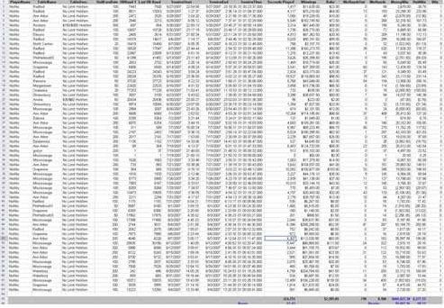
Known data (Training data)
Documents
Labels
Process each data instance to represent it as a feature vector
Tech
Documents
Labels
Health
Feature
Politics
Politics
Sports
Using known data, develop a model to predict unknown data.

Slide 56
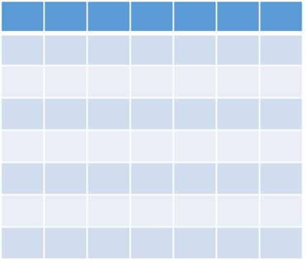
Feature vector
i.e.
Blood Pressure
Age
Height/Weight
Hearth Rate
{40, (180, 82), (11,7), 70, …..} : Healthy
Known data
Features
Label
Data instance
Feature Vector
Notes:
Just a brief info about some keywords used in ML

Slide 57




Developing a Model
Training data
Base Model
Documents
Labels
Feature Vectors
Tech
Adjust
Parameters
Health
Politics
Train the Model
Politics
Sports
Using known data, develop a model to predict unknown data.

Slide 58


Model’s Performance
True
labels
Predicted
labels
Detach
Model’s
Performance
Difference between “True Labels” and “Predicted Labels”
+/-
Known data with true labels
Tech
+/-
Tech
Health
Health
Politics
Politics
Politics
Politics
Tech
Health
Test data 20%
+/-
Sports
Sports
Politics
Politics
Split
Compare prediction
with true labels
Test trained model with features
Training data 80%
Tech
Health
Politics
Train the Model
Sports
Politics
Sports
Notes:
Ratio of the Test/Training data is trivial. Depends on model, data size, quality etc.
Split is random (i.e. which %80 portion of the data?)
There is no rule to split into %80 & %20 … it might be %50 & %50 etc depending on the problem, model, case.
If you are not happy with the Model’s performance than adjust the parameters and re-train the model. Or change the algorithm (training approach) behind the method…

Slide 59
Steps to Build a Machine Learning Solution
1
Problem Framing
2 Get/Prepare Data
3
Develop Model
4
Deploy Model
5
Evaluate / Track Performance
3.1
Analysis/ Metric definition
3.2
Feature Engineering
3.3
Model Training
3.4
Parameter Tuning
3.5
Evaluation

Slide 60
Confusion
Statistics
Develops methods|models that explains data
Data Mining
Find previously unknown schema, patterns in data
Artificial Intelligence
Procedure of programing a computer to behave intelligent
Predictive Analytics
Using Machine Learning techniques to predict future

Slide 61

Example use cases
Finance and risk
Sales and marketing
Customer and channel
Operations and workforce
Revenue Forecasting
Sales forecasting
User segmentation
Agent allocation
$$$
Portfolio optimization
Demand forecasting
Personalized offers
Warehouse efficiency
Investment modelling
Sales lead scoring
Product recommendation
Smart buildings
$$$
Fraud detection
Marketing mix optimization
Predictive maintenance
Risk management
Supply chain optimization
Notes:
Confidential…
+ notes From the book: AzureMachineLearning – AzureFundamentals
Many examples of predictive analytics can be found literally everywhere today in our society:
Spam/junk email filters These are based on the content, headers, origins, and even user behaviors (for example, always delete emails from this sender).
Mortgage applications Typically, your mortgage loan and credit worthiness is determined by advanced predictive analytic algorithm engines.
Various forms of pattern recognition These include optical character recognition (OCR) for routing your daily postal mail, speech recognition on your smart phone, and even facial recognition for advanced security systems.
Life insurance Examples include calculating mortality rates, life expectancy, premiums, and payouts.
Medical insurance Insurers attempt to determine future medical expenses based on historical medical claims and similar patient backgrounds.
Liability/property insurance Companies can analyze coverage risks for automobile and home owners based on demographics.
Credit card fraud detection This process is based on usage and activity patterns. In the past year, the number of credit card transactions has topped 1 billion. The popularity of contactless payments via near-field communications (NFC) has also increased dramatically over the past year due to smart phone integration.
Airline flights Airlines calculate fees, schedules, and revenues based on prior air travel patterns and flight data.
Web search page results Predictive analytics help determine which ads, recommendations, and display sequences to render on the page.
Predictive maintenance This is used with almost everything we can monitor: planes, trains, elevators, cars, and yes, even data centers.
Health care Predictive analytics are in widespread use to help determine patient outcomes and future care based on historical data and pattern matching across similar patient data sets.

Slide 62


Machine Learning Algorithms
ML Algorithm defines how your model will react
Which Algorithm to use? Depends on:
Data Quality
Data Size
What you want to predict
Time constraint
Computation power
Memory limits

Slide 63
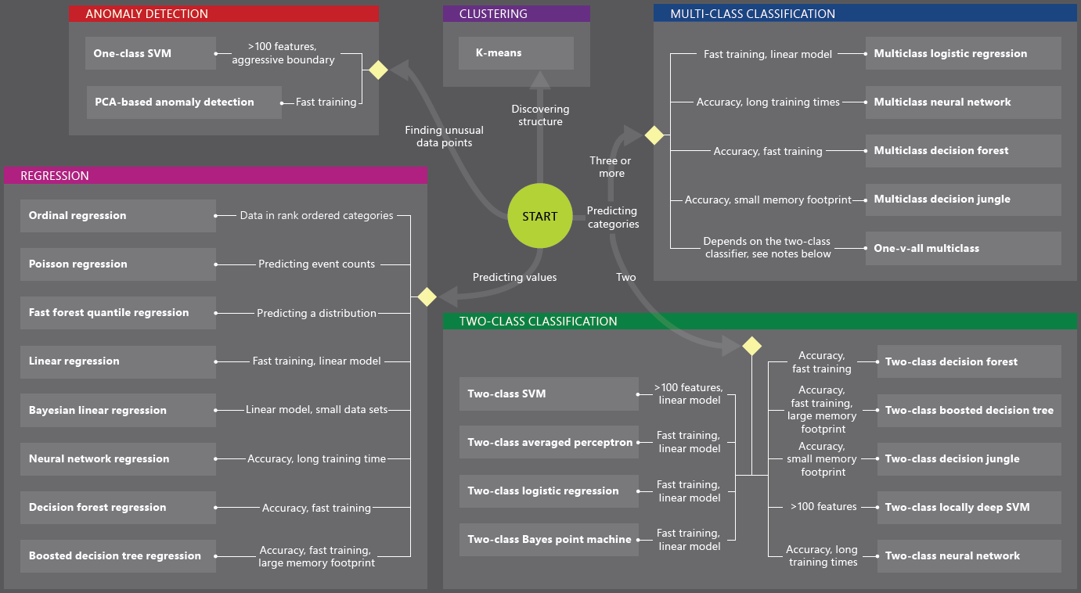
Machine Learning Algorithms
You can develop solutions by using
Custom algorithms written in R | Python
Ready to use ML services from data market
Existing algorithms

Slide 64
Machine Learning Algorithms
Two major category of algorithms
Supervised
Unsupervised
Most commonly used machine learning algorithms are supervised (requires labels)
Supervised learning examples
This customer will like coffee
This network traffic indicates a denial of service attack
Unsupervised learning examples
These customers are similar
This network traffic is unusual
Notes:
How to choose algorithms for Microsoft Azure Machine Learning
https://azure.microsoft.com/en-us/documentation/articles/machine-learning-algorithm-choice/

Slide 65
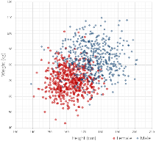
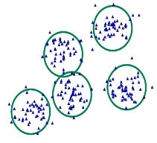
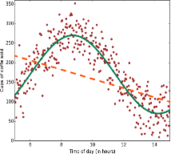
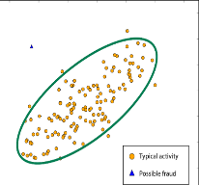
Common Classes of Algorithms (Supervised|Unsupervised)
Classification
Clustering
Regression
Anomaly Detection
Notes:
More samples on: https://azure.microsoft.com/en-us/documentation/articles/machine-learning-algorithm-choice/
Mention about Classification, Regression etc.

Slide 66
Why you need to know these algorithms?
If you want to answer a YES|NO question, it is classification
If you want to predict a numerical value, it is regression
If you want to group data into similar observations, it is clustering
If you want to recommend an item, it is recommender system
If you want to find anomalies in a group, it is anomaly detection
and many other ML algorithms for specific problem

Slide 67
Classification
Scenarios:
Which customer are more likely to buy, stay, leave (churn analysis)
Which transactions|actions are fraudulent
Which quotes are more likely to become orders
Recognition of patterns: speech, speaker, image, movement, etc.
Algorithms: Boosted Decision Tree, Decision Forest, Decision Jungle, Logistic Regression, SVM, ANN, etc.
Classification

Slide 68
Clustering
Scenarios:
Customer segmentation: divide a customer base into groups of individuals that are similar in specific ways relevant to marketing, such as age, gender, interests, spending habits, etc.
Market segmentation
Quantization of all sorts, such as, data compression, color reduction, etc.
Pattern recognition
Algorithms: K-means
Clustering

Slide 69
Regression
Scenarios:
Stock prices prediction
Sales forecasts
Premiums on insurance based on different factors
Quality control: number of complaints over time based on product specs, utilization, etc.
Workforce prediction
Workload prediction
Algorithms: Bayesian Linear, Linear Regression, Ordinal Regression, ANN, Boosted Decision Tree, Decision Forest
Regression

Slide 70
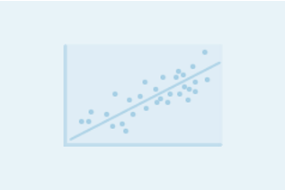

Regression versus Classification
Does your customer want to predict|estimate a number (regression) or apply a label|categorize (classification)?
Regression problems
Estimate household power consumption
Estimate customer’s income
Classification problems
Power station will|will not meet demand
Customer will respond to advertising

Slide 71

Binary versus Multiclass Classification
Does your customer want a yes|no answer?
Binary examples
click prediction
yes|no
over|under
win|loss
Multiclass examples
kind of tree
kind of network attack
type of heart disease

Slide 72
Azure Machine Learning Templates|APIs
An ML Template
Represent best practices of solving an ML problem in a specific domain
Has a data schema applicable to the specific domain
Has domain specific data processing and feature engineering
Uses training algorithms fit to the specific domain
Has domain specific evaluation metric where applicable
Consists of preconfigured ML modules and R scripts to enable e2e solution
Enables user to easily create a custom solution
With user data
With minor adjustment of parameters
Notes:
096_XUE

Slide 73








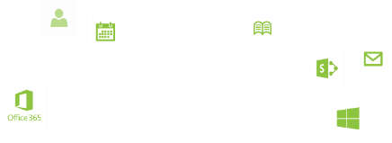


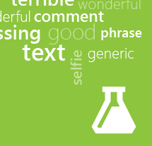



Machine Learning APIs
Face API
Speech API
Vision API
Anomaly
Detection
Customer Churn Prediction
Product Recommendations
Basket Analysis
Text Analytics
Notes:
Conf

Slide 74




COGNITIVE SERVICES
Vision APIs
Face APIs
Speech APIs
LUIS
(Language Understanding Intelligent Service)
Speech Recognition
Analyze Image
Face Detection
Detect Intent
Text to Speech
Generate Thumbnail
Face Grouping
Determine Entities
OCR
Face Identification
Speech Intent Recognition
Improve Models
Notes:
to be replaced with Microsoft Cognitive services.

Slide 75


Smart Buildings
The Center for Building Performance and Diagnostics uses weather forecasts, real-time temperature reads, and behavioral research data to optimize building heating and cooling systems in real-time.
The ease of implementation makes machine learning accessible to a larger number of investigators with various backgrounds—even non-data scientists.
Bertrand Lasternas Carnegie Mellon
“
Key Benefits
User friendly set up and integration with existing systems
Seamless data handling
Accessible and easy to use across backgrounds
Quickly compare algorithms
20% savings on energy costs
”
Notes:
Smart Buildings are the new frontier of optimization for college and business campuses and large buildings like airports and warehouses. Machine Learning allows predictive maintenance of buildings and systems – fixing things before they ever break – and users like Carnegie Mellon are optimizing their heating and cooling across campus for peak and down time and weather patterns. Imagine not heating an entire campus during an unseasonably hot winter day or not cooling it during a Spring cold snap? How much energy and cost would be saved. 20% is what they’re looking at today.
https://customers.microsoft.com/Pages/CustomerStory.aspx?recid=8576
Another example of predictive maintenance is the ThyssenKrupp elevator company, who can now predict elevator issues before they even happen, utilizing the skills of their team in a proactive rather than reactive way.
http://www.microsoft.com/windowsembedded/en-us/internet-of-things-customer-stories.aspx?id=9

Slide 76

Demand Forecasting
Pier 1 partnered with MAX451 to delight loyalty customers by using historical and behavioral data to predict what products they want next.
We are especially pleased that our analysts can focus on the results and not worry about the complex algorithms behind the scenes.
Andrew Laudato Pier 1 Imports
“
Key Benefits
Ease of use across skillsets
Fast time to meaningful results
Accessible via the cloud
Predicting what their customer wants, before they want it
”
Notes:
A vast array of companies can benefit from understanding what they need before they need it and retail customers like Pier 1 are optimizing their marketing down to the individual level across both store and online interactions. Before Azure ML, Pier 1 sent mass emails to all of their customers, advertising the same thing – like outdoor furniture – whether that customer had ever had interest in furniture at all or lived in an applicable place. Today, they’re able to look at past buying behavior, location data and sensor data from their stores to hone in on what will most delight and inspire their customers – and increase their bottom line.
https://www.youtube.com/watch?v=fN8Cixcc5yg&feature=youtu.be
https://customers.microsoft.com/Pages/CustomerStory.aspx?recid=11257

Slide 77





















Notes:
JJ Food Service Food Delivery Servic: Shopping carts that already list what you’re going to order?
Pier 1 Imports : predict which products customers will want in the future
Direct One : Non-sensitive data analysis, using Azure HDInsight for big data analysis and Azure Machine Learning for predictive analytics
Gjirafa: Search Engine for specific language that is not crawled well by major search engines.
JLL: Real Estate search Engine
Carnegie Mellon: more energy efficient buildings
eSmart Systems: automated energy management system
OSIsoft: collect, analyze, and share real-time sensor data to build their mission-critical operations intelligence infrastructure.
Mendeley: providing a faster and more flexible way to share and archive scientific findings and ideas.
Youboox: like Netflix and Spotify, French e-book subscription service: its recommendation engine
WASH Multifamily Laundry: measure company performance and drive productivity.
Kellogg School of Management : Real-world analytics for students
Optolexia: dyslexia screening tool for young childrenv
Rockwell Automation : Data Analysis
Tacoma Public Schools: the district is providing comprehensive data snapshots of student success indicators and has already helped to improve graduation rates from 55 to 78 percent.
Ziosk: predict your preferences and serve them up as part of a better dining experience.
North American Eagle: aggregate and analyze data from prior and current runs to create predictive models
Sun Branding Solutions: packaging text and artwork effectively in ongoing omnichannel campaigns.
The Next Up: predictive analytics about customer traffic based on variables such as weather, historical data, holidays, and major events.
Ultra Tendency: predict when airplanes will arrive at their designated airport gates.
Genscape: transform thousands of streams of energy supply data into consumable intelligence that its customers depend on.

Slide 78

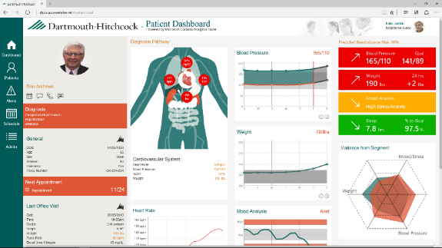
Personalized care delivers healthier populations
“This system is really transforming how we can deliver health and wellness to the population. Despite all of the technology involved, ImagineCare does not lose that human touch, which is so important.”
Nathan Larson Director of Remote Medical Sensing
DARTMOUTH-HITCHCOCK

Slide 79


